Slide 1
Information processing is evolving
A possible scenario

Slide 2
Information changes organization´(Stonier) and thermodynamic improbability is by the 2nd Law of Thermodynamics not enduring for long, i.e. it affords information to last.
Stonier, T. Information und die innere Struktur des Universums; pp. 68-72. Springer Verlag Berlin, Heidelberg, New York (1991). Original: Information and the internal structure of the universe.

Slide 3
When structural information observably changed local probability of a thermodynamically narrow distribution function (i.e. „improbability“) the return to a thermodynamically wide distribution function („high probability“) is constrained.
Differences that make differences alltogether have a physical basis and an evolutionary history of their effectiveness and are therefore powerful factors of evolutionary processes

Slide 4
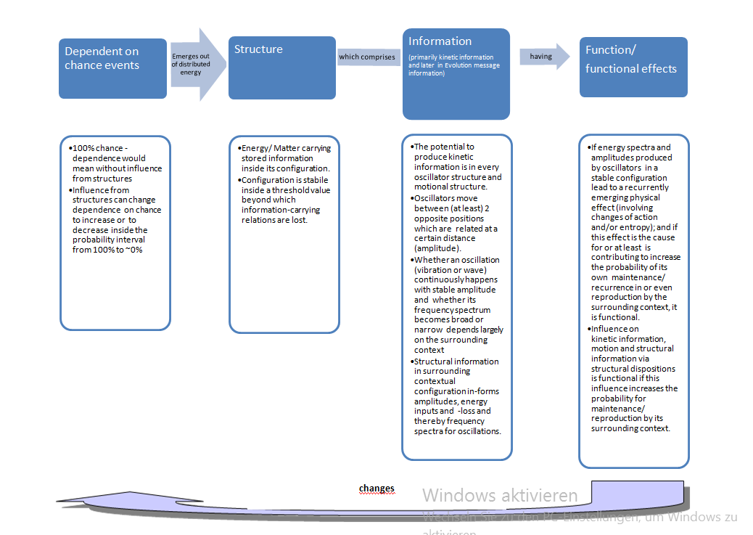
PHYSICAL

Slide 5
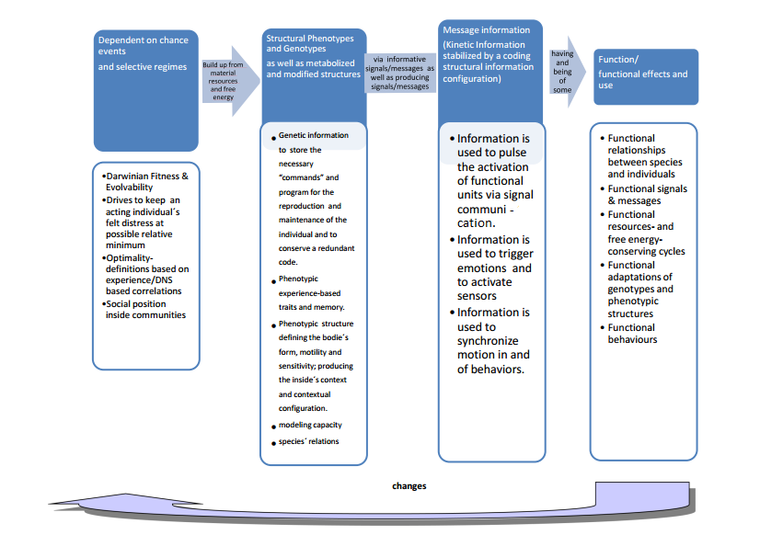
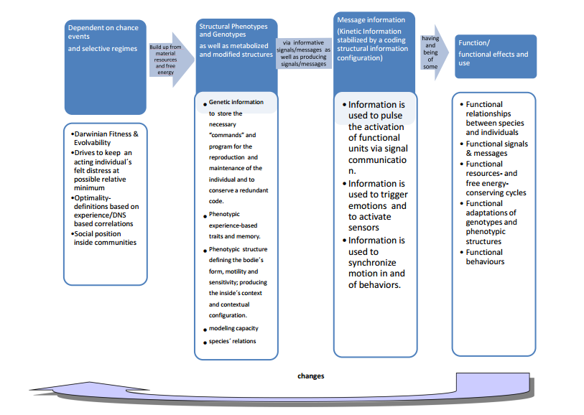
BIOLOGICAL

Slide 6
INTENTIONAL

Slide 7
I would like to end the written discussion and – hopefully inspire a lively discussion about our Intentional Environment´s selecting principles with the words of Rosen:
“I have long believed, and argued, that biology provides us with a vast encyclopedia about how to solve complex problems, and also about how not to solve them. Indeed, biological evolution is nothing if not this, but its method of solution (natural selection) is, by human standards, profligate, wasteful, and cruel. Nevertheless, the solutions themselves are of the greatest elegance and beauty, utterly opposite to the discordances and mortal conflicts that created them.
We cannot use Nature’s methods, but we can (and, I believe, we must) use Nature’s solutions.”
Rosen, R. Essays on life itself; Columbia University Press: New York, 2000.

Slide 8
